Slide 1
Project 1
Data Analytics & Visualization Bootcamp
Rice University - Trilogy
Housing price in Houston Metropolitan areas
Did it soar with decrease of oil price along with/or unemployment?
Fabio Savorgnan
Javier Olivero
Sailendra Mahapatra

Slide 2
Project 1
Outlines:
Introduction Sailendra
Acknowledgements Sailendra
Data source and Methodology
Data Analysis
Crude oil price Fabio
Housing prices
Unemployment
Housing price trends vs Unemployment
Housing price trends vs Oil price
What does the analysis tell Javier
Earning trends in different sectors Javier
Concluding Remarks Sailendra

Slide 3
Project 1
Introduction:
Housing prices:
Influencing factors -
Individual earnings
Geographic location -
School preferences,
Commuting time to work place,
Crime statistics, so on ...
In the present analysis,
We try to examine the following factors which would have influenced earning potentials for the rise/fall of house pricing in Houston metropolitan areas:
Oil price
Unemployability
Average income
As we will see, through the course of this presentation, the housing price is influenced by unemployment rate, where as not solely oil price changes has no influence.

Slide 4
Project 1
Acknowledgements:
We are thankful to our mentor/instructor Camden Kirkland for his valuable guidance, time and constant encouragement.
Our sincere thanks to Trilogy and Rice University for conducting the Boot Camp and allowing us to learn and carry out the present analysis
Thanks are also due to Kaggle, Bureau of Labor Statistics, US Energy Information Administration (eia), Python/Lib developers for data and coding

Slide 5
Project 1
Data source & Methodology:
The data are retrieved through python coding from the below data sources.
Housing data -- https://www.recenter.tamu.edu/data/housing-activity
Oil price -- https://www.eia.gov/dnav/pet/pet_pri_spt_s1_m.htm
Unemployment rate -- https://www.recenter.tamu.edu/data/employment/
We used python coding to retrieve the data and utilized Pandas for creating relevant dataframes for counties in the Houston Metropolitan areas
The Maplotlib and Numpy libraries were utilized to create various plots

Slide 6
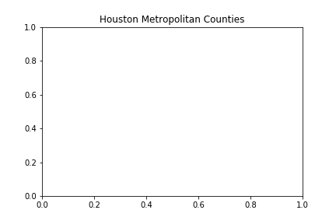

Slide 7
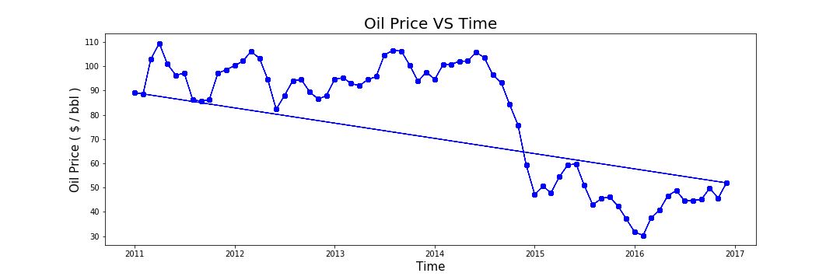
Project 1
Oil price remains over $90/bbl for most part of 2011 – mid 2014
It declines sharply to $48/bbl as it reaches year 2015

Slide 8
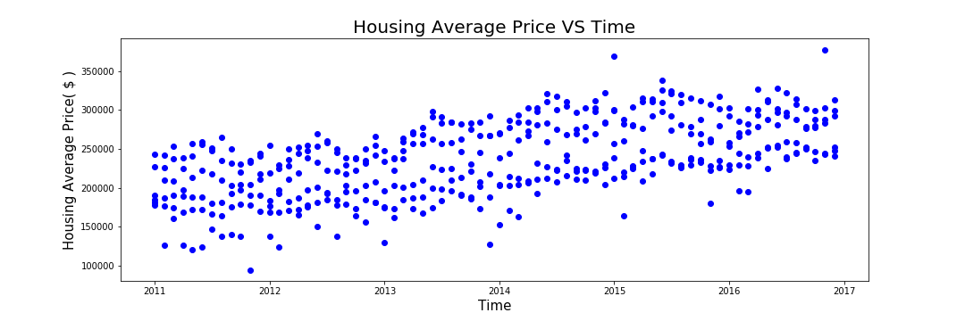
Project 1
Average housing prices per month are plotted
The cost over counties show a gradual increases from $250k to $335k from 2011 till 2017

Slide 9
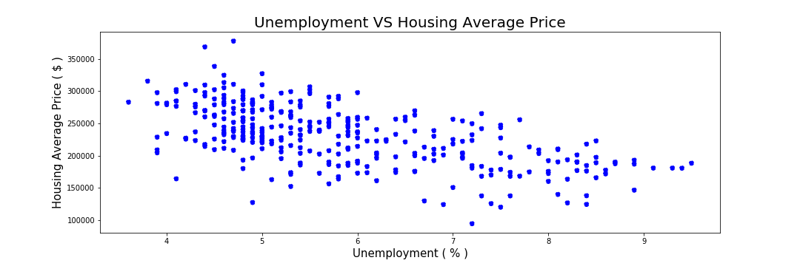
Project 1
The monthly average housing prices for the period changes as the unemployment increases

Slide 10
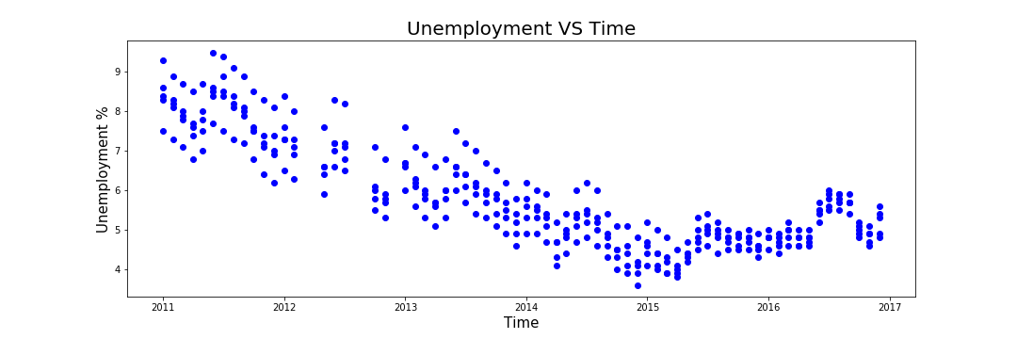
Project 1
The unemployment rate decreases over time

Slide 11
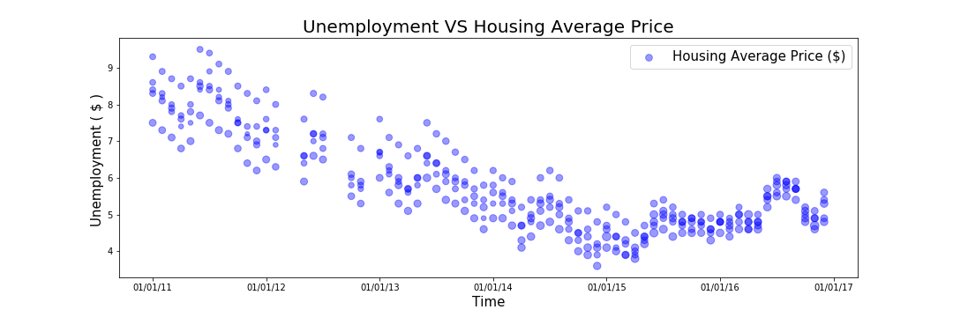
Project 1
The unemployment % for the period shows a gradual decrease with less than 4% in Dec 2014
The bubbles are scaled on housing average price

Slide 12
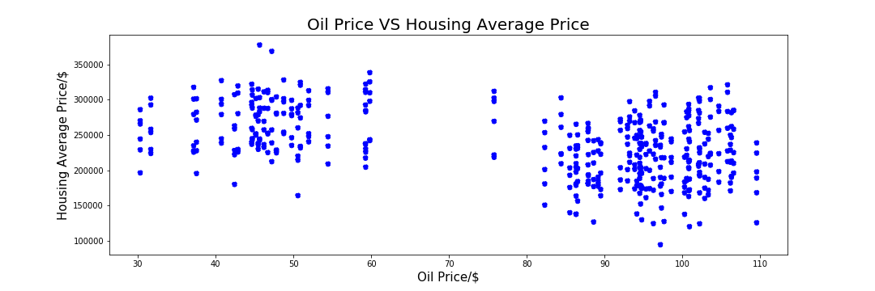
Project 1
Sudden drop of
oil prices
The monthly average housing prices for the period changes very slightly
The gap in the middle corresponds to sudden drop of oil prices over the period

Slide 13
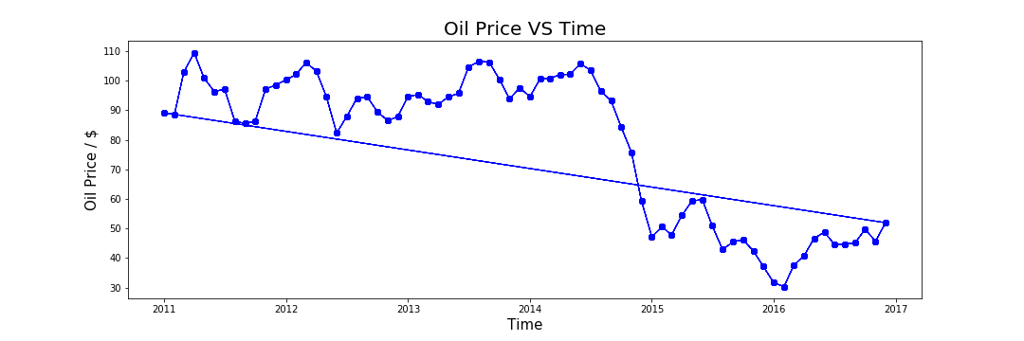
Project 1
Gap ???
It tells us that the unemployment rate and housing price are mostly dependent
The oil price fluctuation does not show any corresponding change in housing price and unemployability over the counties

Slide 14
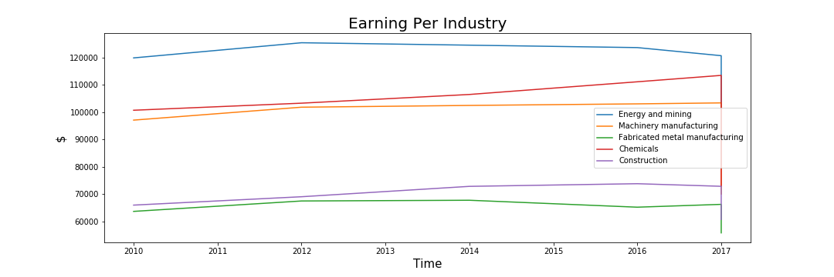
Project 1
Check Title / Y Legend placing, Utilities??
Decrease
Increase
It tells us that the unemployment rate and housing price are mostly dependent
The oil price fluctuation does not show any corresponding change in housing price and unemployability over the counties

Slide 15
Thank You for your time and patience !
Questions ???

Slide 16
Project 1
Introduction:
Historically, oil prices rises and falls over time based on market demands, production quantities and geo-political scenarios, etc.
Does employment associated with this industry is affected by this rise & fall ?
Does the sale values of houses fluctuate as per the employment scenarios (earning capacity) ?
In the present analysis, we analyze the above scenarios in the Houston Metropolitan counties
As we will see, through the course of this presentation, the housing price & unemployment rate are not solely affected by oil price changes over a period of seven (7) years

